Slide 1

Topic: Fractions
EQ: How do we divide fractions?
Instructions:
Read the instructions on slide 1 (don’t forget to listen to the audio icon)
Read and copy the notes on slide 2
View the YouTube clip (slide 3) and add in any hints/tips that help you to divide fractions
Read and copy slide 4. This is your example. Remember to use highlighters/different colours to emphasise the steps.
On your LHS work through the 4 practice questions
Work through the questions on T1W8_Lesson 4_Division of fractions worksheet that is in the Lesson 4 folder (the same folder where you found this PowerPoint)
Once you have completed the worksheet I would like for you to take a photo and add it to the submission folder on Connect

Slide 2
Topic: Fractions
EQ: How do I divide fractions?
Review from last lesson
1. Go to quizizz.com. Click on “Join a game”. Enter the code 909076. Enter your full name (first and second name), so that I know it is you! O the quiz that I have created for you.
2. Once you have opened a word document and write a summary sentence on how you multiply fractions. Save this document in this way ( First name.Last name_ Multiplying fractions summary)
3. Go to the submission folder icon on the Connect page and upload this document

Slide 3



Topic: Fractions
EQ: How do I divide fractions?
reciprocal
To find the reciprocal of a fraction you must invert the fraction. This is done by swapping the numerator and the denominator. ‘flipping the fraction’
Dividing by a fraction
Dividing by a fraction is the same as multiplying by the reciprocal
$$\frac{2}{3}÷\frac{1}{2}$$
$$=\frac{2}{3}×\frac{2}{1}$$
$$= \frac{2×2}{3×1}=\frac{4}{3} = 1\frac{1}{3}$$
Mixed numbers must be changed to improper fractions

Slide 4
https://youtu.be/t_3afn9L7XU

Slide 5
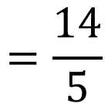
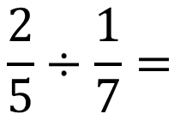
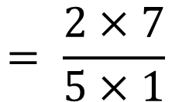



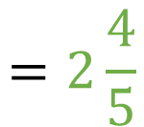
Topic: Fractions
EQ: How do I divide fractions?
Keep
Flip
Change
$$\frac{2}{5}÷\frac{1}{7}=$$
$$\frac{2}{5}$$
$$\frac{7}{1}$$
$$= \frac{2×7}{5×1}$$
$$=\frac{14}{5}$$
$$=2\frac{4}{5}$$
$$×$$

Slide 6

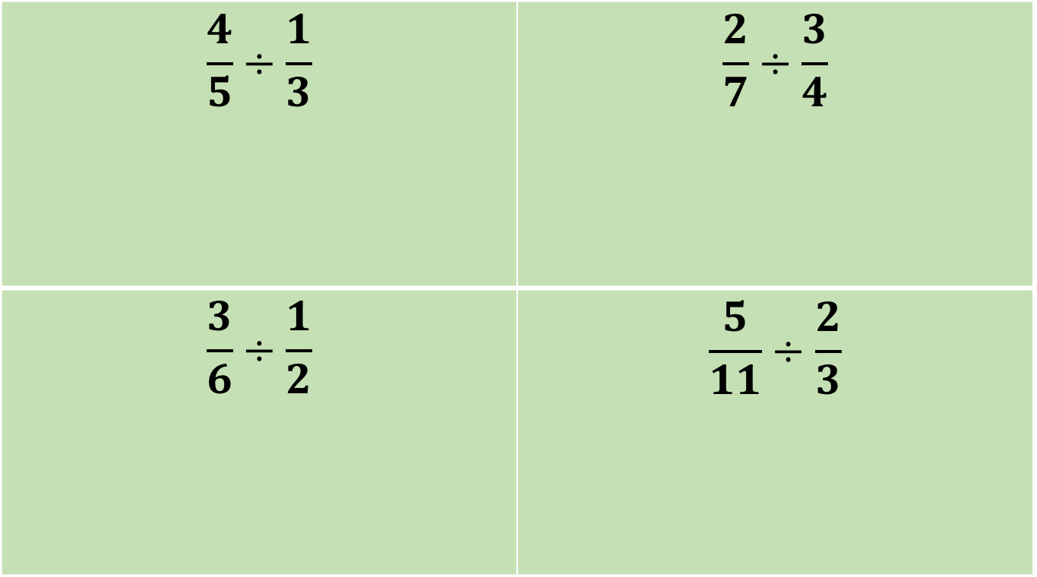
Practice Time!
On your left hand side
$$\frac{4}{5}÷\frac{1}{3}$$ | $$\frac{2}{7}÷\frac{3}{4}$$
$$\frac{3}{6}÷\frac{1}{2}$$ | $$\frac{5}{11}÷\frac{2}{3}$$

Slide 7
Complete worksheet on dividing fractions
T1W8_Lesson 4_Division of fractions worksheet

Slide 8
Summary
To divide fractions we…….

